Slide 1

MONGO DB

Slide 2
MONGO DB
MongoDB is a document database.
It stores data in a type of JSON format called BSON.
A record in MongoDB is a document, which is a data structure composed of key value pairs similar to the structure of JSON objects.
Records in a MongoDB database are called documents, and the field values may include numbers, strings, booleans, arrays, or even nested documents.

Slide 3
MONGO DB
MongoDB is a NoSQL open-source, document-oriented database developed for storing and processing high volumes of data.
Compared to conventional relational databases, MongoDB makes use of collections and documents instead of tables consisting of rows and columns.
The collections consist of several documents containing the basic units of data in terms of key and value pairs.

Slide 4
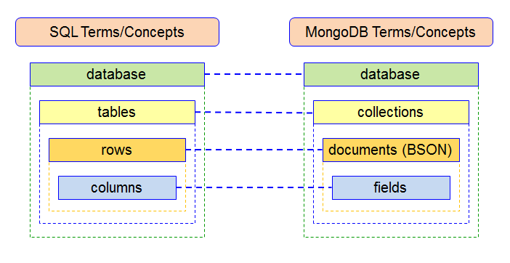
Compare MongoDB with a traditional RDBMS

Slide 5
MongoDB editions
1) MongoDB Community Server
The MongoDB Community Edition is free and available on Windows, Linux, and macOS.
It offer MongoDB as a service to the public
2) MongoDB Enterprise Server
MongoDB Enterprise Server is a commercial edition of MongoDB as a part of the MongoDB Enterprise Advanced subscription.
3) MongoDB Atlas
MongoDB Atlas is a global cloud database service. It is a database as a service that allows you to focus on building apps rather than spending time managing the databases.
MongoDB Atlas is available on common cloud platforms such as AWS, Azure, and GCP. MongoDB Atlas has a free tier for your experiments.

Slide 6
Setup Mongo DB
Official site: MongoDB: The Developer Data Platform | MongoDB
To download MONGODB COMMUNITY SERVER
Download MongoDB Community Server | MongoDB
Steps :Install MongoDB Community Edition on Windows — MongoDB Manual
To Download MongoDB Shell
MongoDB Shell Download | MongoDB

Slide 7
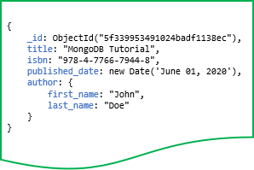
Documents
MongoDB stores data records as BSON documents, which are simply called documents

Slide 8
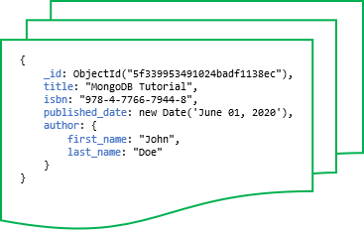
Collections
MongoDB stores documents in a collection. A collection is a group of documents.

Slide 9
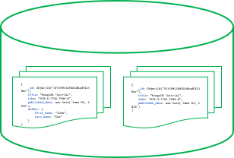
Databases
MongoDB stores collections into a database. A single instance of MongoDB can host multiple databases.

Slide 10
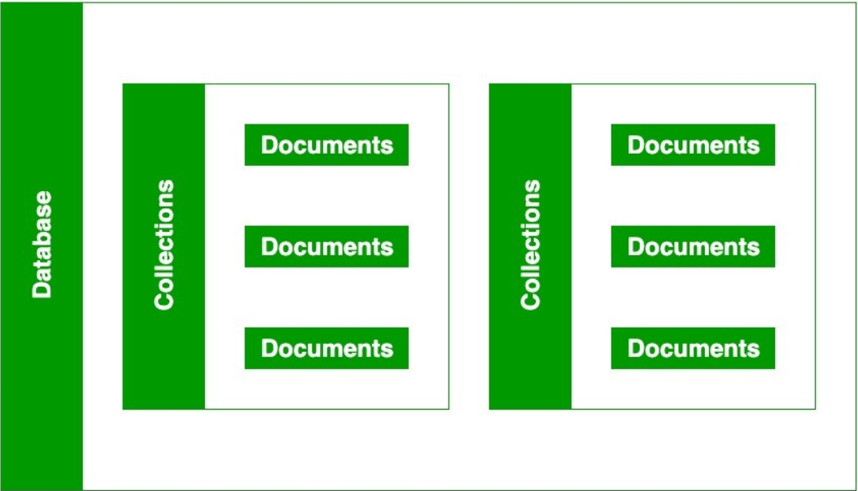
Database, Collection, and Document

Slide 11
CRUD Operations with MongoDB
CREATE- Adding new documents to a collection
READ - Selecting documents
UPDATE -Updating existing documents
DELETE - Removing documents from a collection

Slide 12
1. Adding new documents to a collection
insertOne() – method allows you to insert a single document into a collection
db.collection.insertOne(
<document>,
{ writeConcern: <document>} )
insertMany() – allows you to insert multiple documents into a collection
db.collection.insertMany(
[document1, document2, ...],
{
writeConcern: <document>, ordered: <boolean>
} )

Slide 13
2. Selecting documents
findOne() – returns a single document from a collection that satisfies the specified condition.
db.collection.findOne(query, projection)
find() – method finds the documents that satisfy a specified condition and returns a cursor to the matching documents.
db.collection.find(query, projection)

Slide 14
3. Updating documents
updateOne() method allows you to update a single document that satisfies a condition.
db.collection.updateOne(filter, update, options)
updateMany() method allows you to update all documents that satisfy a condition.
db.collection.updateMany(filter, update, options)

Slide 15
4. Deleting documents
deleteOne() method allows you to delete a single document from a collection.
db.collection.deleteOne(filter, option)
deleteMany() method allows you to remove all documents that match a condition from a collection.
db.collection.deleteMany(filter, option)

Slide 16
Mongo shell
The mongo shell is an interactive JavaScript interface to MongoDB.
The mongo shell allows you to manage data in MongoDB as well as carry out administrative tasks.

Slide 17
Mongo shell
db test
The mongo shell is a MongoDB client. By default, the mongo shell connects to the test database on the MongoDB server and assigns the database connection to the global variable called db
test> show dbs
admin 41 kB
config 73.7 kB
local 81.9 kB

Slide 18
shell
Show dbs
use BankServer
show collection
db.users.findOne({“acno”:”1000”})
db.users.insertOne({uname:”Amal”,balance:50000})
db.users.find({balance:{$gt:4000})
db.users.deleteOne({uname:”Amal”})

Slide 19
Creating Documents
Create a db Mydata
Create a collection monuments
Insert one document using insertOne():
db.monuments.insertOne(
{
"name": "The Pyramids of Giza",
"city": "Giza",
"country": "Egypt",
"gps": {
"lat": 29.976480,
"lng": 31.131302
}
}

Slide 20
Creating Documents
db.monuments.count()
Insert many documents using insertMany():
db.monuments.insertMany([
{"name": "The Valley of the Kings", "city": "Luxor", "country": "Egypt", "gps": { "lat": 25.746424, "lng": 32.605309 }},
{"name": "Arc de Triomphe", "city": "Paris", "country": "France", "gps": { "lat": 48.873756, "lng": 2.294946 }},
{"name": "The Eiffel Tower", "city": "Paris", "country": "France", "gps": { "lat": 48.858093, "lng": 2.294694 }},
{"name": "Acropolis", "city": "Athens", "country": "Greece", "gps": { "lat": 37.970833, "lng": 23.726110 }},
{"name": "The Great Wall of China", "city": "Huairou", "country": "China", "gps": { "lat": 40.431908, "lng": 116.570374 }},
{"name": "The Statue of Liberty", "city": "New York", "country": "USA", "gps": { "lat": 40.689247, "lng": -74.044502 }}
])
db.monuments.count()

Slide 21
Find all documents using find():
db.monuments.find()
db.monuments.find().pretty()
Find one document using findOne():
db. monuments.findOne({"name": "Arc de Triomphe"})

Slide 22
Update one document using updateOne():
db.monuments.updateOne(
{ "name": "Arc de Triomphe" },
{
$set: { "name": "Arc de Triomphe de l'Étoile" }
}
)

Slide 23
Update many documents using updateMany():
db.monuments.updateMany(
{ },
{
$set: { "editor": “Username" }
}
)

Slide 24
Deleting Documents
db.monuments.deleteOne(
{ "name": "Arc de Triomphe de l'Étoile" }
)
db.monuments.deleteMany(
{ "editor": "Sammy" }
)

Slide 25
Tasks
What is the difference between MongoDB and MYSQL
Create a db and collection of student data, perform the crud operation

